Slide 1
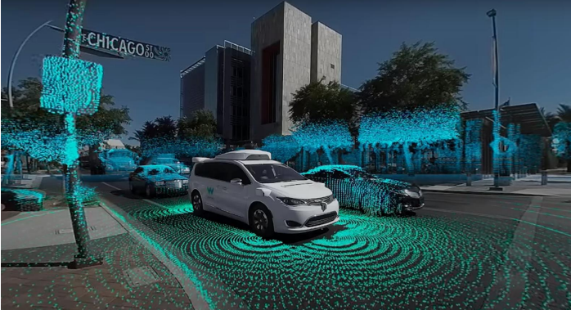
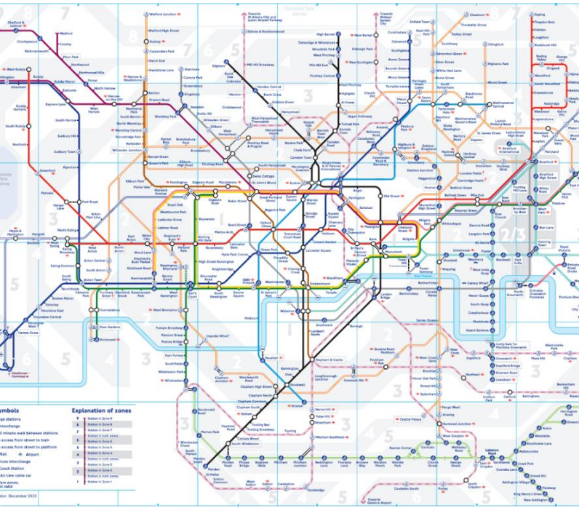
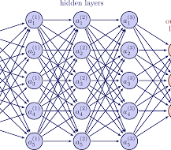
Learning graph rewiring project
By
Yahav Vanun
Nitzan Leshem Yaniv Hassidof

Slide 2
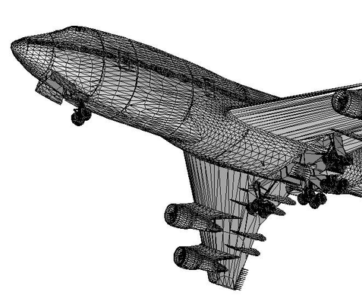
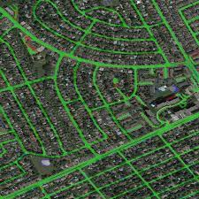
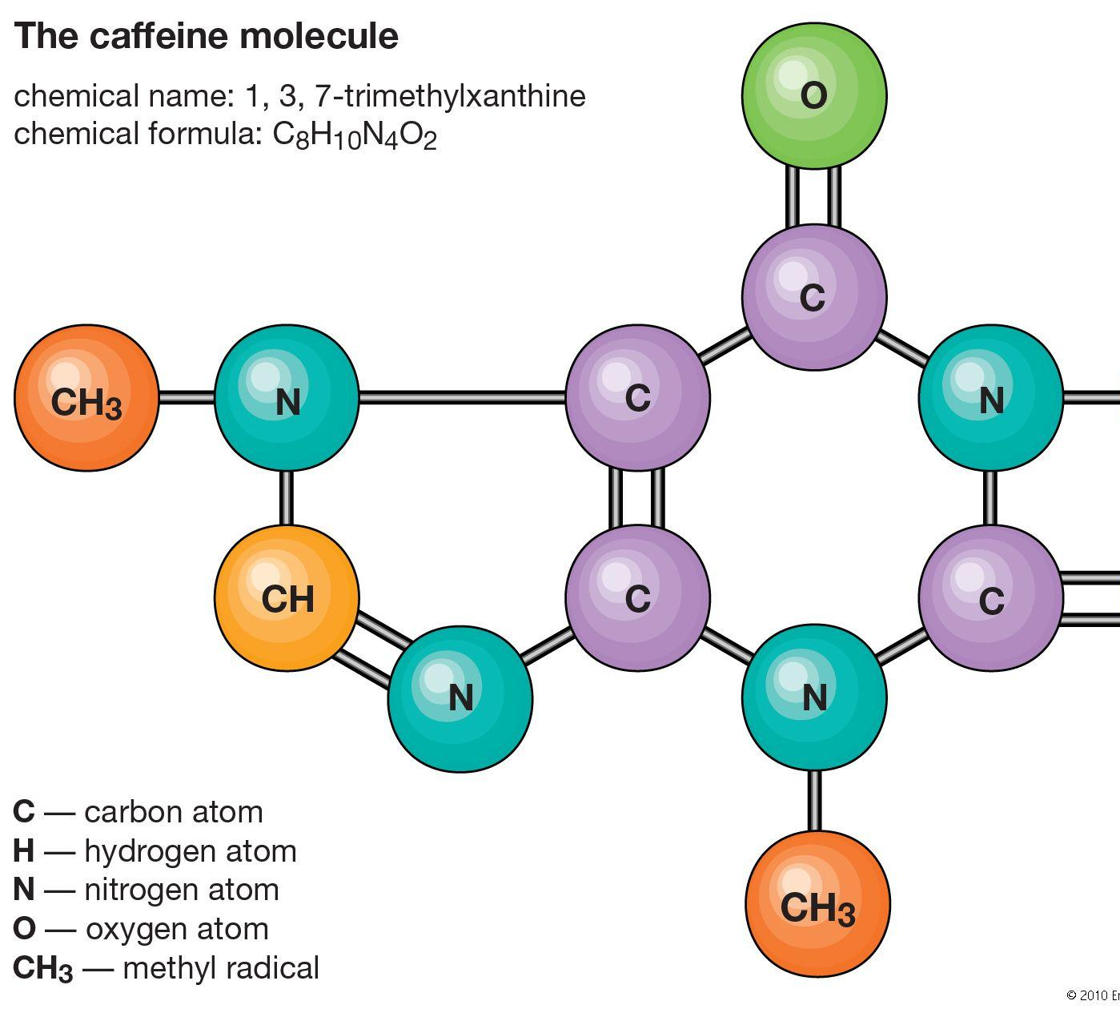
Introduction
In this project we will try to learn how to rewire the graph by adding and removing edges to assist information transfer using 3 different methods- Link prediction through Meta learning, Reinforcement learning and Minimum Spanning Tree.
Notes:
קיפול חלבונים – אתגר עצום בביולוגיה שפתרו עם רשתות נוירונים לגרפים

Slide 3
Methods
Notes:
חיזוי עומס בצומת בודד ברשת כבישים חיזוי או סימולציה פיזיקלית של עצם תלת מימדי חיזוי על מולקולה של תרופה מסויימת – מה יהיו תופעות הלוואי

Slide 4
Graph rewiring by Reinforcement learning
In our RL approach we formulate graph rewiring as a game where an agent has to decide which edges to prune\wire in order to achieve maximal performance on a given task.
We chose the proximal policy optimization(PPO) algorithm to solve the task since it is a good general purpose algorithm. It requires little hyperparameter tuning and as such we preferred using it over other algorithms that might fit the task better but would require a large investment in tuning.
The PPO algorithm includes an actor network trained to choose the best action, and a critic network trained to help the actor with better predictions of the value of each state.
Both of these networks are trained using gradient descent methods to find both the optimal policy and the approximate value function. Since the possible state space is enormous for large graphs, we use a trained Graph Attention network to create a graph embedding.
For the Cora dataset our node representation is a vector of length 8, such that the graph is represented by a 2078x8 matrix. Our actor network was configured to output 2 real continuous values (x,y), such that the edge between nodes (x,y) would be wired or trimmed if it already exists. We attempted using discrete actions as output, but the resulting actor network was too large to fit in our memory during training.

Slide 5
Graph rewiring by Attention weights
Method I - One-shot Rewiring
In this method we try to mitigate over-squashing by pruning edges with low attention scores as well as allow message passing between distant nodes by adding edges with high attention scores.
We trained a multi-headed two-layer graph neural network using its original edges on a specific task and then used its attention scores to prune and add edges (we averaged the scores over the attention heads to get a single score for each edge) and using the new edges we retrained the model from scratch.
Our pruning is done by defining the percentage of the edges we wish to remove and then removing the edges with the lowest scores until we reach our goal. For edge addition we tried two methods, the first is predefining an amount of edges to add and then add the edges with the highest scores until we reach our goal, In our second method we added the single highest scored edge for each node.
We did the same rewiring experiment to both the first attention layer and the second layer together using each layer's attention scores, as well as each of the layers separately.
Method II - Iterative Rewiring
In this method we implemented iterative edge pruning and addition.
In each epoch we prune a small portion of the edges from the previous epoch and add a small portion of new edges according to the edges attention scores. We do this for each layer separately (different graph connectivity for each layer). We enforce that the number of edges we remove at each epoch is bigger than the number of edges added, therefore the more epochs the algorithm runs the less total edges remain in the graphs.

Slide 6
Graph rewiring by Graph rewiring by MST (Minimum Spanning Tree)
We first trained GAT on the Cora dataset to get baseline results to compare with later.
Then, we ran Kruskal’s algorithm on the Cora dataset and received the minimum spanning tree (or minimum spanning forest, in case the graph is not connected) of the graph.
With this information, we tried 2 things- the first is to include only the edges of the MST which heavily diluted the graph (by more than 50%) and the second is to add the MST edges to the graph (which increased the amount of edges by ~50%).
Then we trained the GAT again on the new graphs and examined the results.

Slide 7
Results
When running the GAT model on the Cora dataset we got a baseline result of 82% accuracy.
Notes:
חיזוי עומס בצומת בודד ברשת כבישים חיזוי או סימולציה פיזיקלית של עצם תלת מימדי חיזוי על מולקולה של תרופה מסויימת – מה יהיו תופעות הלוואי

Slide 8
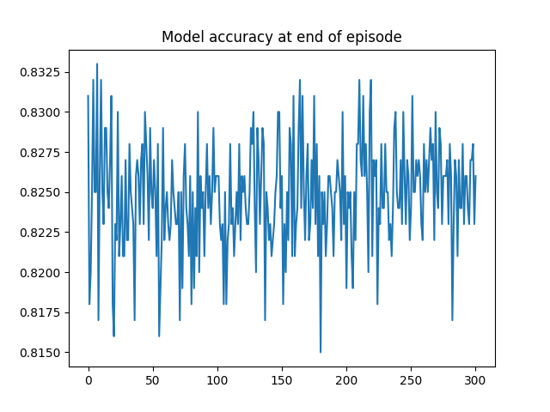
Graph rewiring by Reinforcement learning
On the Cora dataset our RL agent achieved 83.3% accuracy, showing it was able to find a rewiring with reduced information squashing. The training lasted 300 episodes, while in each episode the agent took 1000 actions. Training took 1 hour on our RTX 2070 card. The graph does not show a convergence, indicating that perhaps longer training will yield better final results.

Slide 9
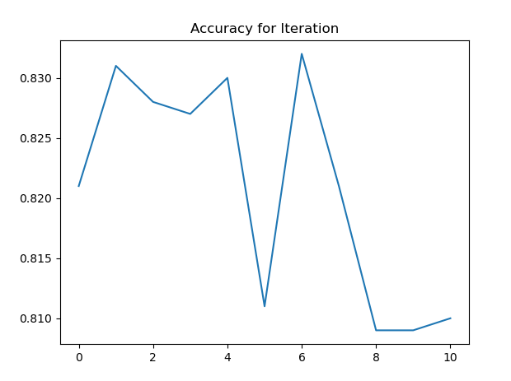
Graph rewiring by Attention weights
We ran the following three tests for each layer separately and both layers together.
1.Only prune
2.Only Add (percentage/each node)
3.Prune and Add
We ran all of the tests 10 times, once with the percentage-add and once with each-node add.
One-Shot Rewiring-
Iterative Rewiring-
Model | Average Accuracy | Max Accuracy | STD
Base | 0.825 | 0.832 | 0.004
First_Layer_Prune | 0.816 | 0.837 | 0.01
First_Layer_Add | 0.817 | 0.827 | 0.007
First_Layer_Both | 0.825 | 0.832 | 0.005
Second_Layer_Prune | 0.822 | 0.832 | 0.006
Second_Layer_add | 0.816 | 0.826 | 0.007
Second_Layer_Both | 0.824 | 0.833 | 0.005
Both_Layers_Prune | 0.821 | 0.832 | 0.007
Both_Layers_Add | 0.812 | 0.827 | 0.008
Both_Layers_Both | 0.818 | 0.831 | 0.01
Pruning usually hurts performance but results have high STD
Adding to first alone layer hurts performance, adding to second layer alone helps performance, adding to both layers helps even more

Slide 10
Graph rewiring by Graph rewiring by MST (Minimum Spanning Tree)
After finding the MST, and updating the graph edges to include only the MST’s edges, we received 77% accuracy.
The result clearly indicates a reduction in accuracy (-5% from baseline) with this method. But on the positive side, with the reduction of edges to train on comes an improvement in training time- we noticed a 20-25% improvement in training time.
Also, when adding the MST edges to the existing graph edges we received accuracy of 75% (-7% from baseline), which is much worse accuracy and has no other benefits. We would not recommend doing this.

Slide 11
Conclusion
We have seen that there were improvements in some of the methods (improved accuracy), and deterioration in others (decreased accuracy, sometimes with other benefits such as improved training times). There is still much research needed to be done in order to achieve major improvements in accuracy results with graph rewiring.
Notes:
חיזוי עומס בצומת בודד ברשת כבישים חיזוי או סימולציה פיזיקלית של עצם תלת מימדי חיזוי על מולקולה של תרופה מסויימת – מה יהיו תופעות הלוואי

Slide 12
Future work
For the RL approach the AlphaZero algorithm by deepmind shows great promise, with its variant AlphaTensor being used to discover the fastest ever matrix multiplication algorithm.
AlphaTensor formulates matrix multiplication as a game where the agent needs to find the actions that achieve the correct result in the minimal amount of steps. Such RL algorithms are much more efficient than brute-force search even when purpose trained for a single problem(e.g., for each matrix size).
The AlphaZero algorithm incorporates planning ahead with Monte - Carlo Tree Search to better predict the value of a state.
The algorithm is very well suited for problems with a huge state space, such as chess or in our case all the different graph wiring configurations. Another major improvement would be to use a better graph embedding, Perhaps using unsupervised methods.
A better permutation - invariant embedding might result in an agent that could generalize to new unseen graphs and rewire them immediately with no extra training.
Notes:
חיזוי עומס בצומת בודד ברשת כבישים חיזוי או סימולציה פיזיקלית של עצם תלת מימדי חיזוי על מולקולה של תרופה מסויימת – מה יהיו תופעות הלוואי

